Slide 1

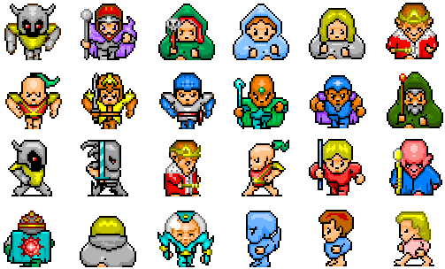
7. Sprites
Let’s Learn
Aj. Andrew Davison, CoE, PSU Hat Yai Campus
E-mail: ad@fivedots.coe.psu.ac.th

Slide 2
Outline
Game Things in Pygame (again)
The Pygame sprite Module
The Sprite Class
Groups of Sprites
Types of Collision Detection
beachBounce.py (again)
Finding Images for Sprites

Slide 3
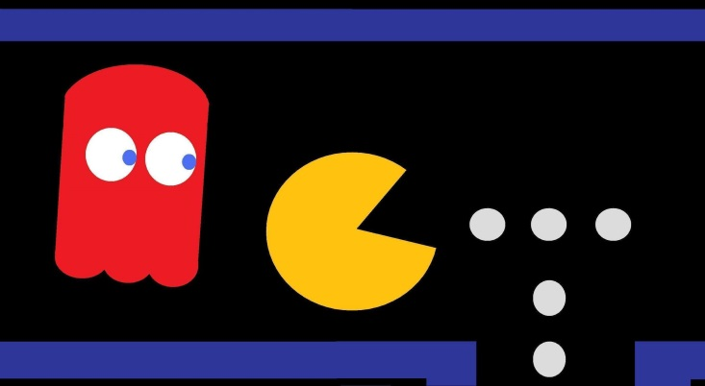
1. Game Things in Pygame (again)
sprites: moving game characters / objects
collision detection: which sprites are touching?
event: a user action (e.g. mouse or key press), or computer change (e.g. clock tick)
game loop:
read new events
update sprites and game state
redraw game

Slide 4
2. The Pygame sprite Module
http://www.pygame.org/docs/ref/sprite.html
The pygame.sprite module includes:
a Sprite class for creating Sprite objects
we will create game sprites by inheriting Sprite
a Group class for grouping sprites together
this makes it easier to test, update and draw many sprites at once
lots of collision detection functions
test if a sprite hits another sprite (or a group of sprites)

Slide 5


3. The Sprite Class
Every sprite object contains an image and a rectangle (which contains its (x,y) position, width and height).
Sprite includes many functions for adding the sprite to groups.
Sprite object
image
(x,y)
rect
h
w
other
optional
data
a sprite is moved
by changing the
(x,y) value in rect

Slide 6
The image Data
Sprite image data is a Pygame surface
a surface can be created from a loaded picture, or by converting shapes (e.g. lines, circles, rect), or by converting text strings
Some useful surface functions:
Surface((width, height)) | makes new Surface of given size
fill((red, green, blue)) | makes surface the given color (rgb 0-255)
get_width(), get_height() | returns the size of the surface
get_rect() | returns a Rect holding the (x,y), width, height of the surface

Slide 7
3.1. My BallSprite Class
BallSprite object
image
class BallSprite(pygame.sprite.Sprite):
def __init__(self, fnm):
super().__init__()
self.image = pygame.image.load(fnm).convert_alpha()
self.rect = self.image.get_rect()
self.rect.center = [scrWidth/2, scrHeight/2]
# start position of the ball
# in center of window
self.xStep, self.yStep = self.randomSteps()
# step size and direction along each axis
def randomSteps(self):
# create a random +/- STEP pair
x = STEP
if random.random() > 0.5:
x = -x
y = STEP
if random.random() > 0.5:
y = -y
return [x,y]
(x,y)
rect
h
w
xStep
yStep
xStep and yStep
will be used to move the sprite
scrWidth, scrHeight, STEP
are globals – see later

Slide 8
horizWalls, vertWalls
are globals – see later
def update(self):
if pygame.sprite.spritecollideany(self, horizWalls):
# change y-step direction at top and bottom sides
self.yStep = -self.yStep
if pygame.sprite.spritecollideany(self, vertWalls):
# change x-step direction at left and right sides
self.xStep = -self.xStep
self.rect.x += self.xStep # move the ball horizontally
self.rect.y += self.yStep # and vertically

Slide 9
3.2. My BlockSprite Class
The image is a black rectangle.
BlockSprite object
image
(x,y)
rect
height
class BlockSprite(pygame.sprite.Sprite):
def __init__(self, x, y, width, height):
super().__init__()
self.image = pygame.Surface((width, height))
self.image.fill(BLACK)
self.rect = self.image.get_rect()
self.rect.topleft = (x, y)
width

Slide 10
4. Groups of Sprites
Sprite objects can be grouped together inside a Group object:
# create wall sprites
top = BlockSprite(0, 0, scrWidth, WALL_SIZE)
bottom = BlockSprite(0, scrHeight-WALL_SIZE, scrWidth, WALL_SIZE)
left = BlockSprite(0, 0, WALL_SIZE, scrHeight)
right = BlockSprite(scrWidth-WALL_SIZE, 0, WALL_SIZE, scrHeight)
horizWalls = pygame.sprite.Group(top, bottom)
vertWalls = pygame.sprite.Group(left, right)
The sprites in a group can be tested, updated and drawn using functions:
vertWalls.draw(screen) # draws both sprites (left, right)

Slide 11
Different ways of Grouping
The sprite module contains a few different ways to group sprites
beachBounce.py will use Group and OrderedUpdates
Group groups sprites in no order
OrderedUpdates groups sprites in order

Slide 12


5. Types of Collision Detection
Using rectangles
often too big, but fast to test
Using circles
how big should the circles be?
Using the images' non-transparent pixels
slow but most accurate

Slide 13

All three approaches are in the sprite module:
pygame.sprite.collide_rect(sprite1, sprite2)
uses self.rect data in the Sprite objects
pygame.sprite.collide_circle(sprite1, sprite2)
requires self.radius data in the Sprite objects
pygame.sprite.collide_mask(sprite1, sprite2)
requires self.mask data in the Sprite objects
a mask is a black and white version of the sprite that shows its outline
image
mask

Slide 14
Collision Detection with Groups
spritecollideany(sprite, group)
Returns True if sprite has collided with any sprite in the group
spritecollide(sprite, group, kill)
Returns a list of all sprites in group that collide with sprite
If kill is True, a collision causes sprite to be deleted
groupcollide(group1, group2, kill1, kill2)
Returns list of all sprites in group1 that collide with group2

Slide 15
See BlockSprite.update()
def update(self):
if pygame.sprite.spritecollideany(self, horizWalls):
# change y-step direction at top and bottom sides
self.yStep = -self.yStep
if pygame.sprite.spritecollideany(self, vertWalls):
# change x-step direction at left and right sides
self.xStep = -self.xStep
self.rect.x += self.xStep # move ball horizontally
self.rect.y += self.yStep # and vertically

Slide 16
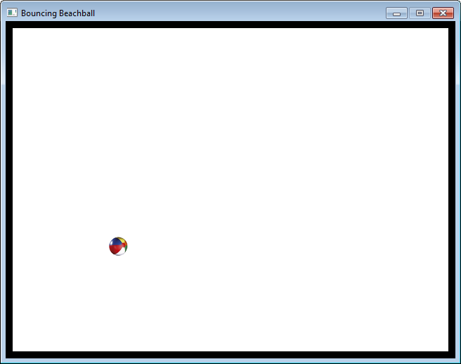
6. beachBounce.py (again)
The same bouncing ball example as before, but coded using sprites.
note the black "walls" around the sides of the window

Slide 17
Code
BLACK = ( 0, 0, 0)
WHITE = ( 255, 255, 255)
WALL_SIZE = 10
STEP = 10
class BlockSprite(pygame.sprite.Sprite):
# see slide 9
class BallSprite(pygame.sprite.Sprite):
# see slides 7 - 8

Slide 18
# ---------- main -------------
pygame.init()
screen = pygame.display.set_mode([640,480])
screen.fill(WHITE)
pygame.display.set_caption("Bouncing Beachball")
scrWidth, scrHeight = screen.get_size()
# create wall sprites
top = BlockSprite(0, 0, scrWidth, WALL_SIZE)
bottom = BlockSprite(0, scrHeight-WALL_SIZE, scrWidth, WALL_SIZE)
left = BlockSprite(0, 0, WALL_SIZE, scrHeight)
right = BlockSprite(scrWidth-WALL_SIZE, 0, WALL_SIZE, scrHeight)
horizWalls = pygame.sprite.Group(top, bottom)
vertWalls = pygame.sprite.Group(left, right)
ball = BallSprite('smallBall.png')
# sprites = pygame.sprite.Group(top, bottom, left, right, ball)
sprites = pygame.sprite.OrderedUpdates(top, bottom,
left, right, ball)
clock = pygame.time.Clock()

Slide 19
running = True
while running:
clock.tick(30)
# handle events
for event in pygame.event.get():
if event.type == QUIT:
running = False
# update game state
ball.update()
# redraw
screen.fill(WHITE)
sprites.draw(screen) # draws all 5 sprites
pygame.display.update()
pygame.quit()
Here is the benefit of using Sprite and Group – the game loop becomes very simple.

Slide 20
7. Finding Images for Sprites
You can draw your own using any paint program!
Some good sites:
Video Game Sprites: http://www.videogamesprites.net/
Spriters Resource: http://www.spriters-resource.com/
Open Game Art: http://opengameart.org/
A great list of websites at "16 Sites to Download the Best Free Game Graphics":
https://blog.felgo.com/game-resources/16-sites-featuring-free-game-graphics

